Slide 1

Analysis of NBA Salary and Salary Cap data from 1990-2018
By Bruno Magnani

Slide 2
Outline of the Presentation
The presentation is to examine the Salary data of 36 teams in the NBA each season during the 1990-2018 time frame. For each team within this period, I plotted line graphs showing the Salary and the NBA Salary Cap, and examined the movement of the Salary in relation to each team’s performance each season with a view to extracting insights to inform us of the reasons for the respective salary levels. Throughout this analysis I compared the Salary levels to the NBA Salary Cap.
Overview of the Data
The data consisted of Salaries paid to 36 teams in the NBA for each season within the 1990-2018 time frame with their corresponding NBA Salary Cap. I calculated the percentage change of the Salary Cap-Salary between consecutive seasons and examined these percentage changes. For each team per season, I found it more beneficial to examine the relationship between the performance and the Salary movement to extract insights as to why the Salary moved in the way it did and how it related to the Salary Cap.

Slide 3
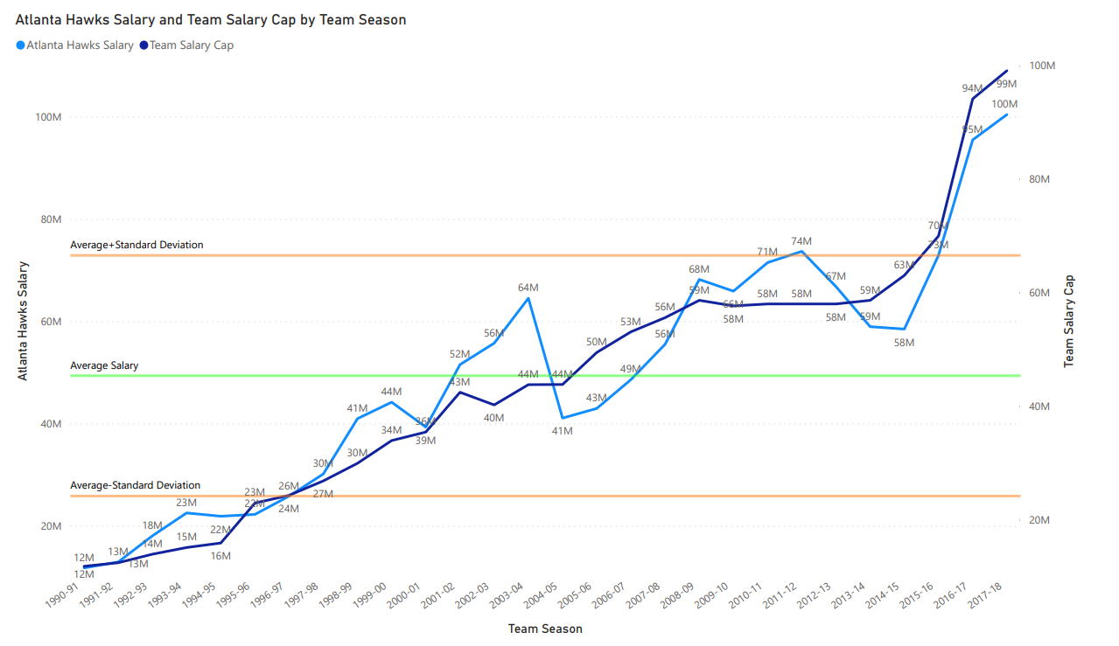

Slide 4
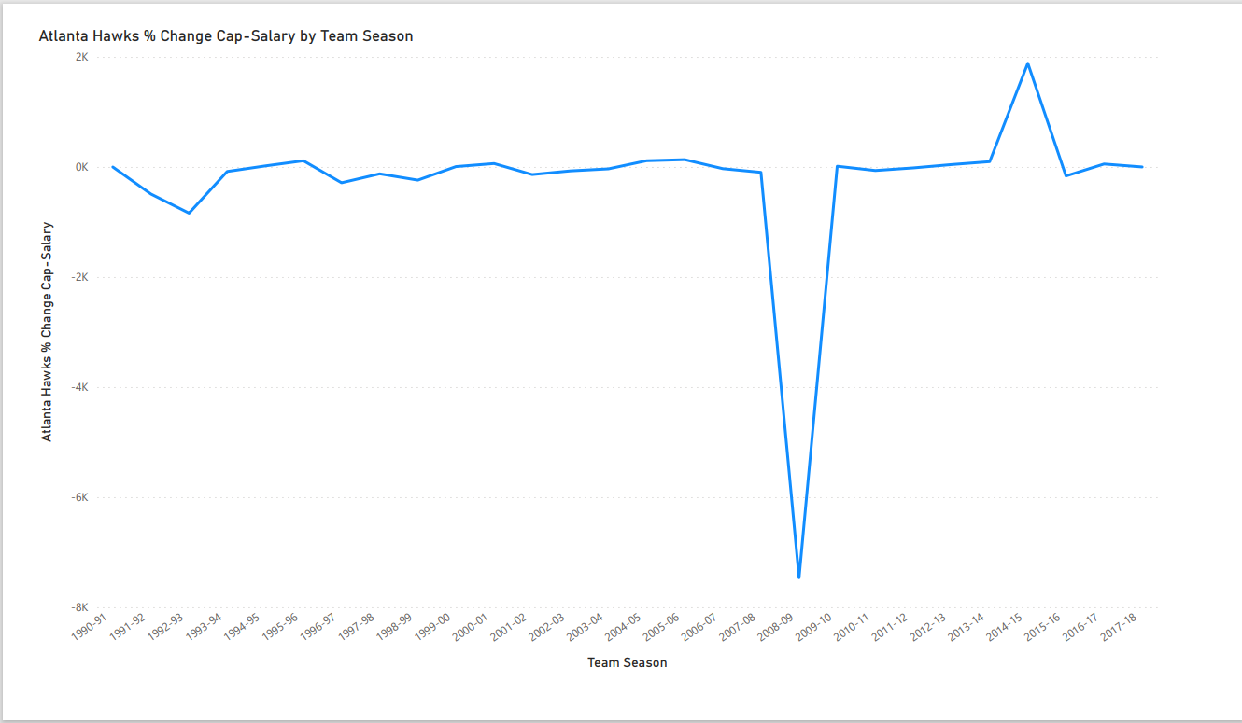

Slide 5
As you can see from the data from 1990-1995 and from 2016-2018, they fall outside of the limits of the Standard Deviation. Therefore, 19 years worth of data out of 28 years occurs within the Standard Deviation Limits, showing how far spread the data is about the mean.
The data also shows that there is a correlation between the Atlanta Hawks Salary and the Salary Cap, which is what you would expect as the Salary Cap is a benchmark for the salaries paid.
I also calculated the percentage change of the Salary Cap-Salary between consecutive seasons and found that this figure between the 2007-2008 and 2008-2009 seasons was -7463.28%. At the end of the 2008-2009 season, the Atlanta Hawks finished second in the NBA South Eastern Conference. Another significant percentage change of the Salary Cap-Salary occurred between the 2013-2014 and the 2014-2015 seasons where there was a percentage increase of 1885.22%.

Slide 6
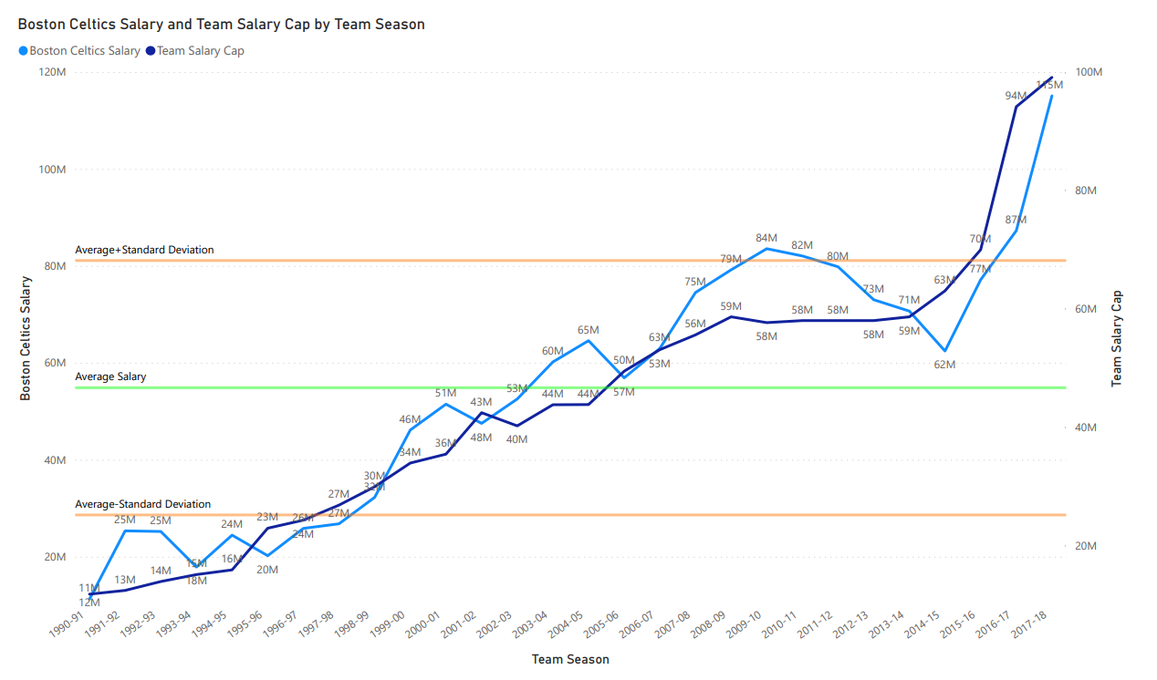

Slide 7
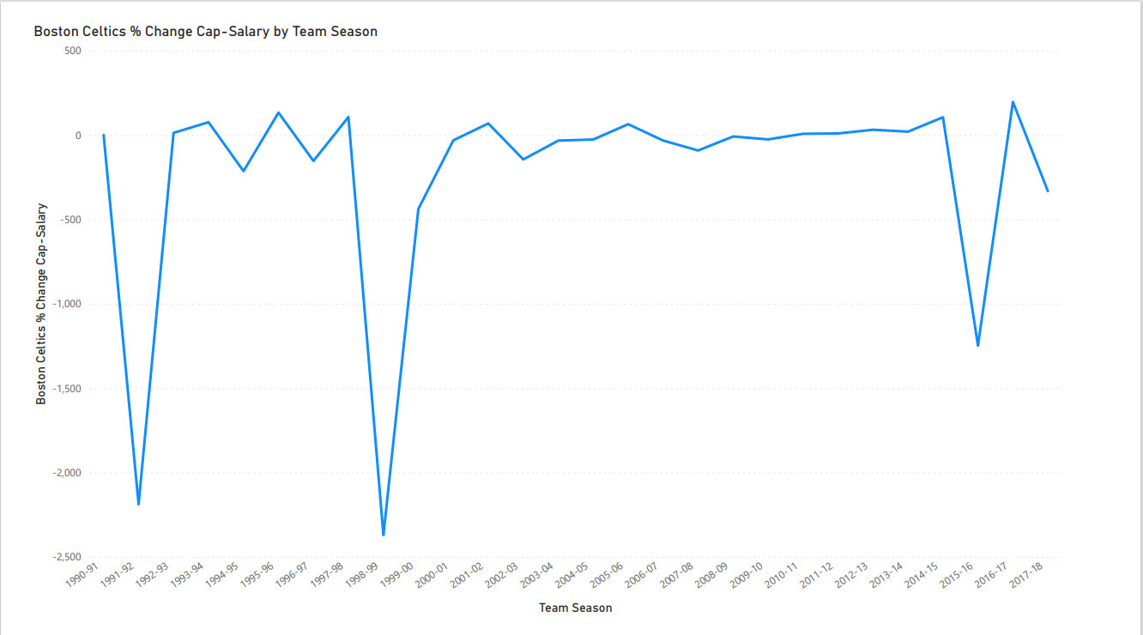

Slide 8
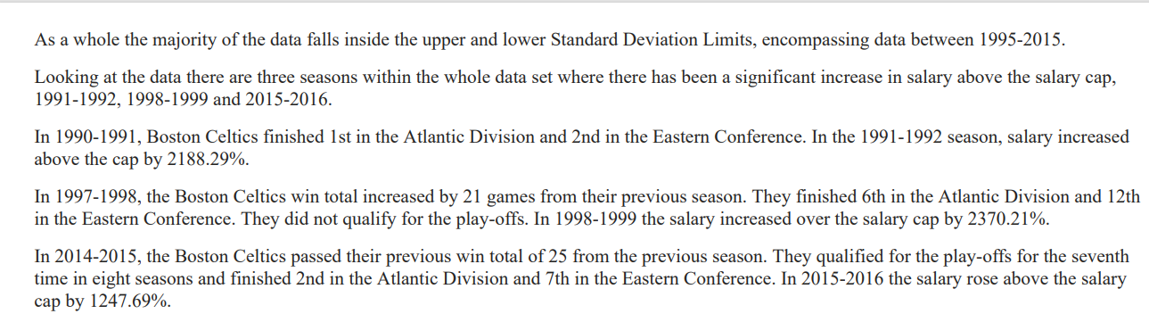

Slide 9
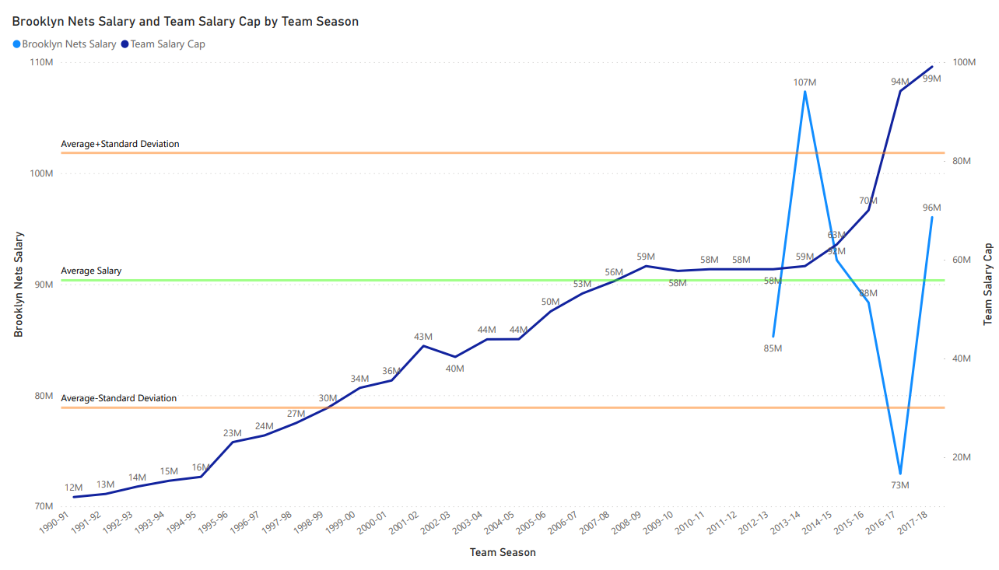

Slide 10
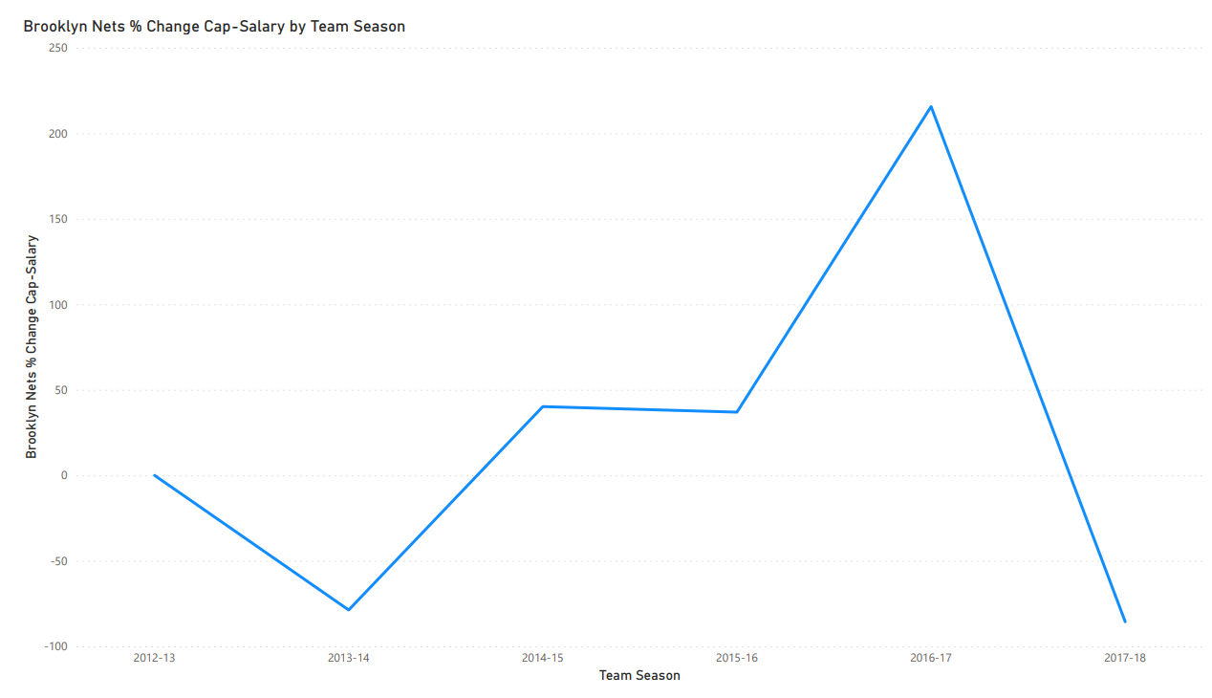

Slide 11
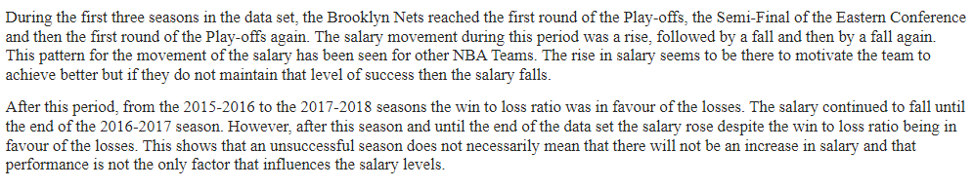

Slide 12
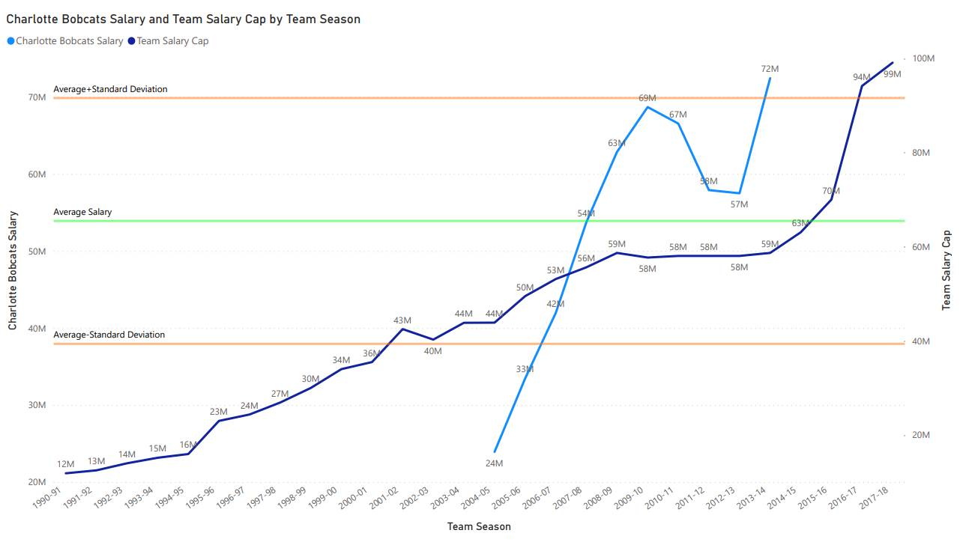

Slide 13
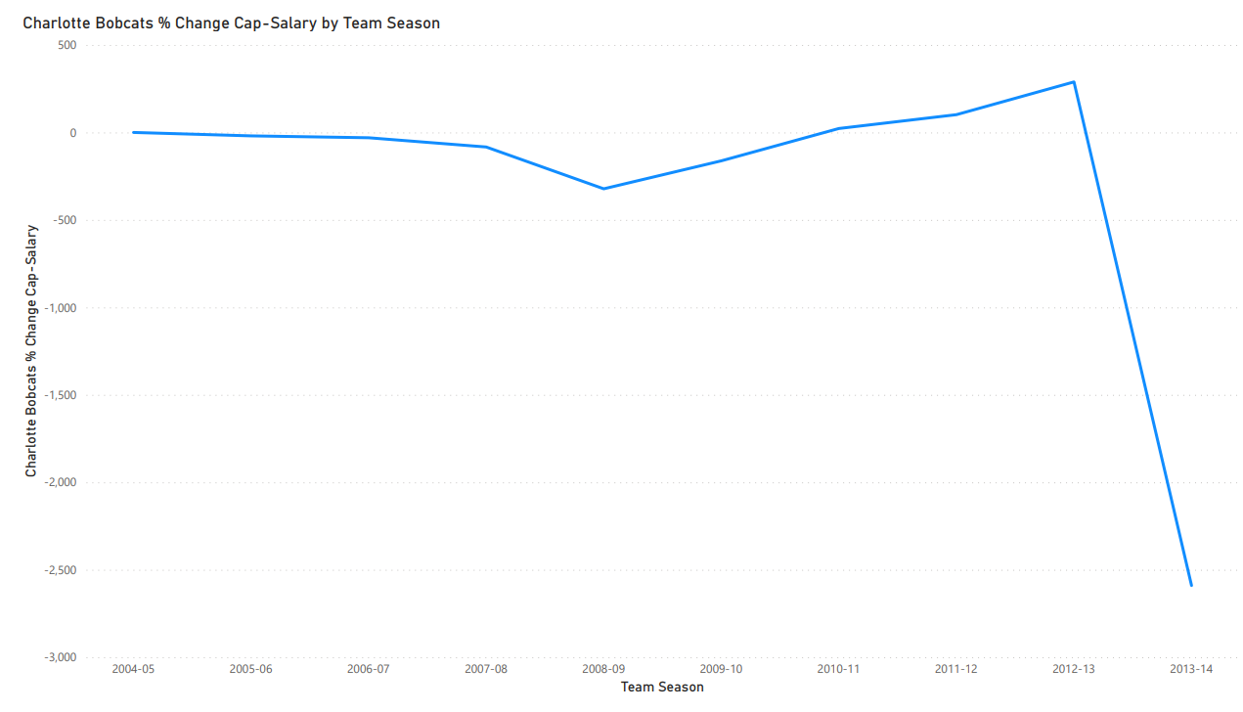

Slide 14
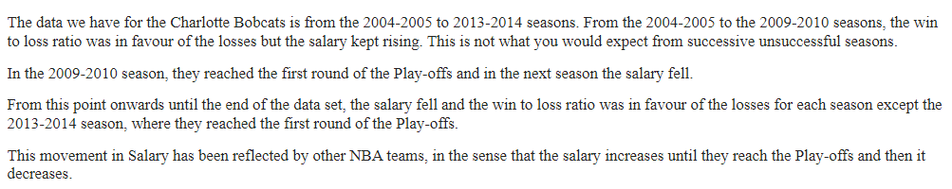

Slide 15
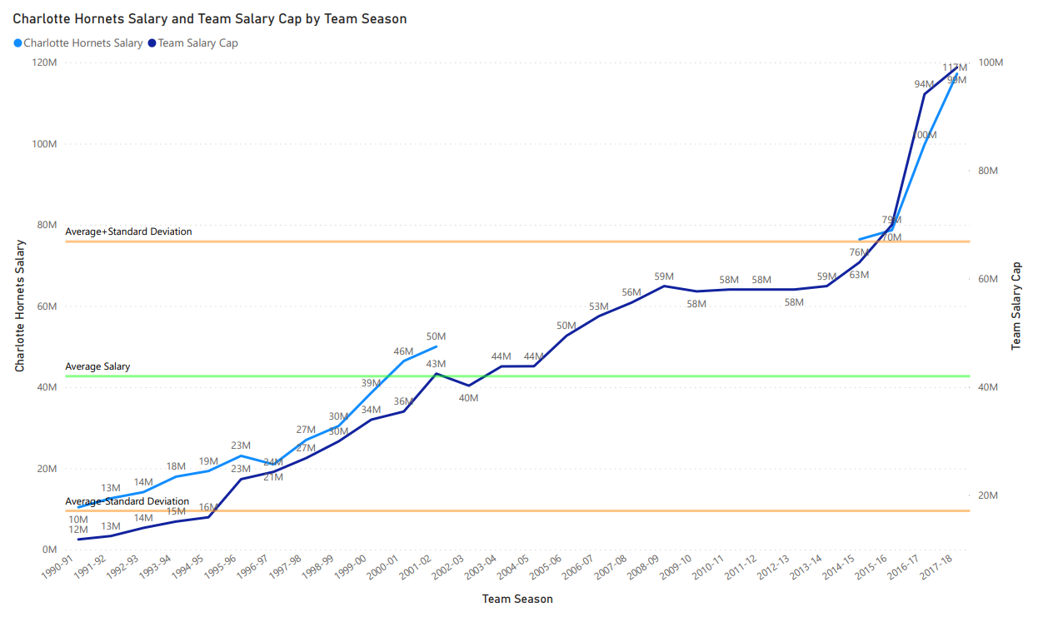

Slide 16
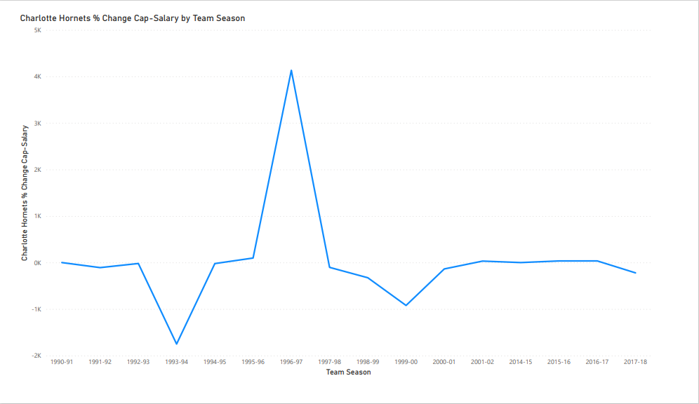

Slide 17
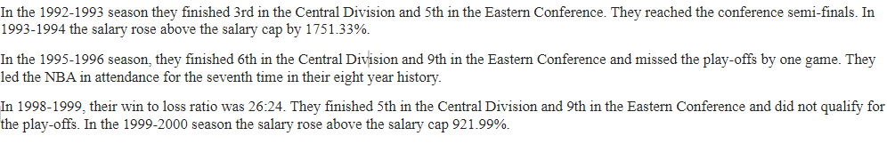

Slide 18
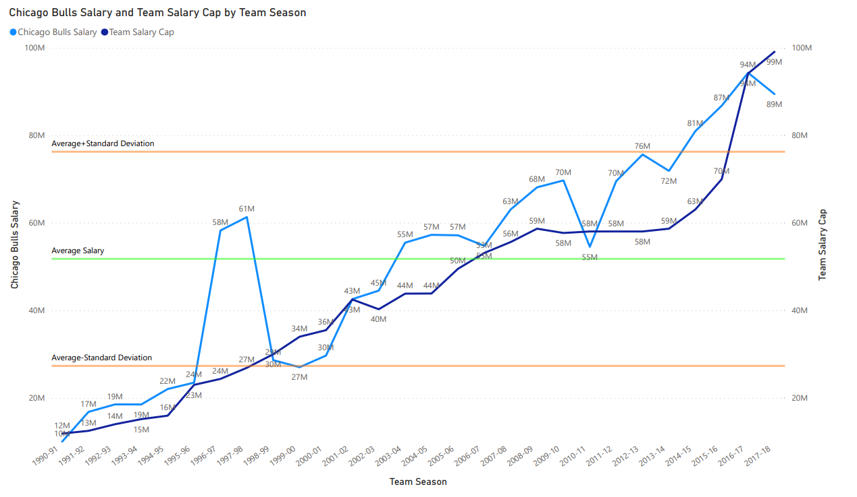

Slide 19
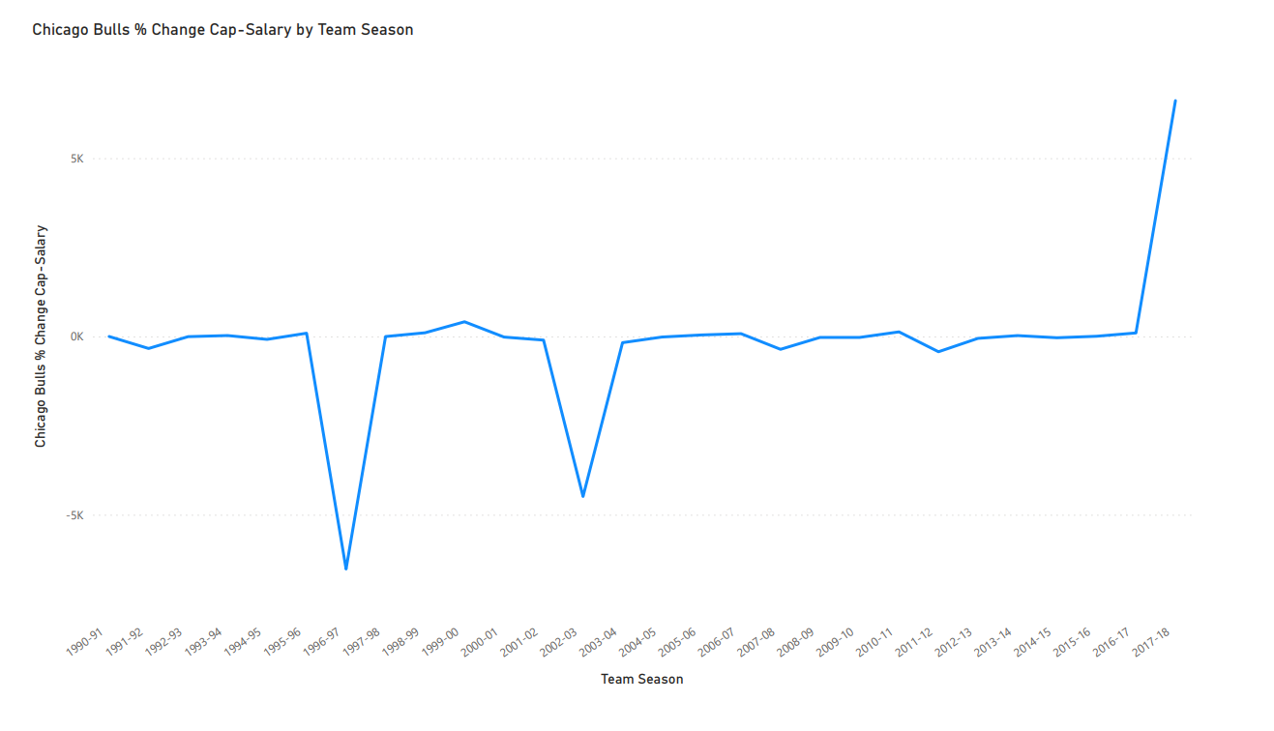

Slide 20
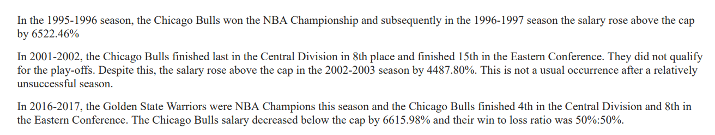

Slide 21
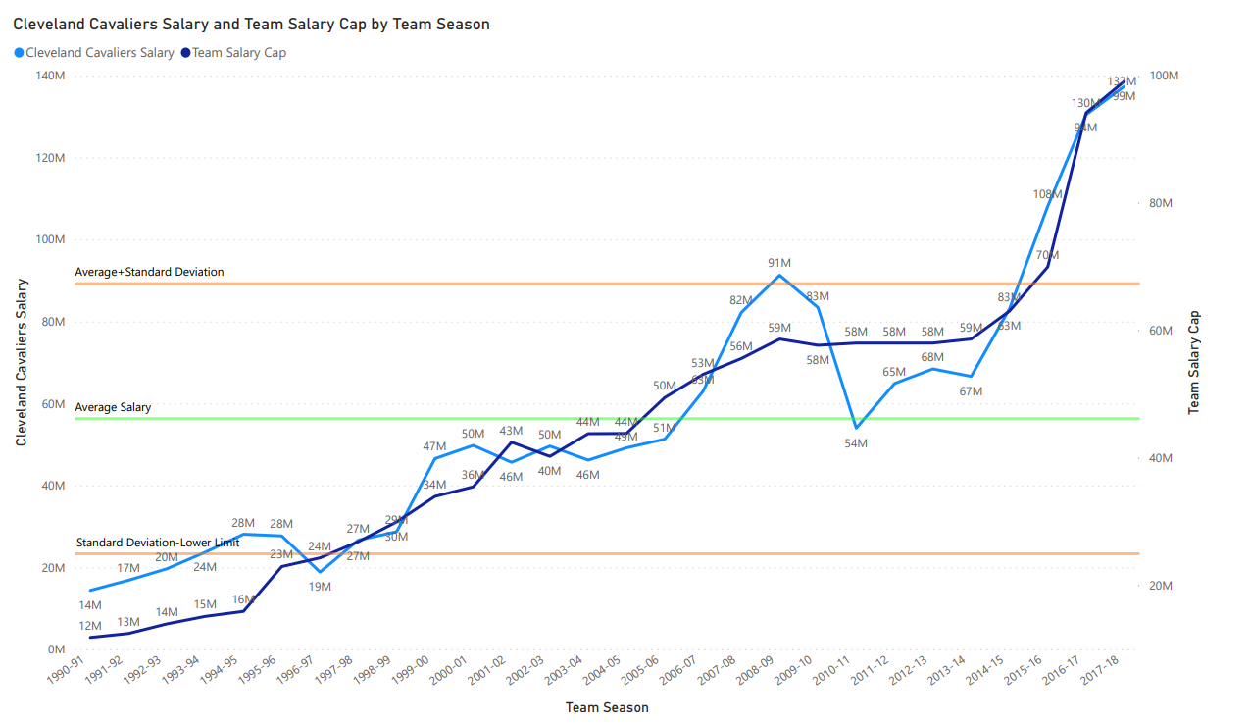

Slide 22
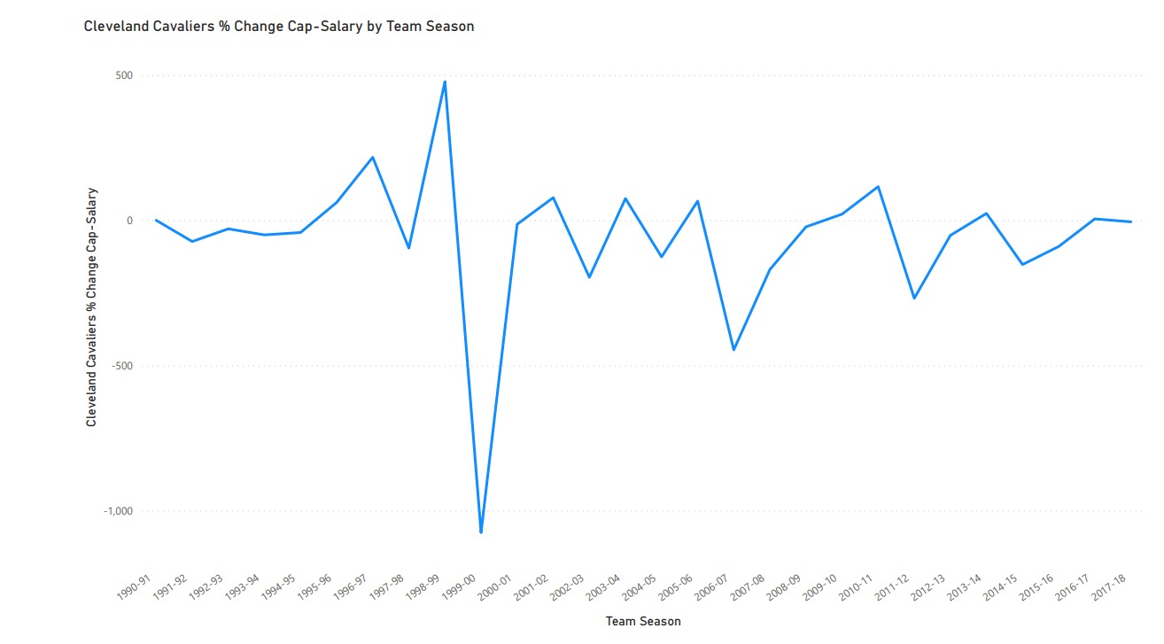

Slide 23
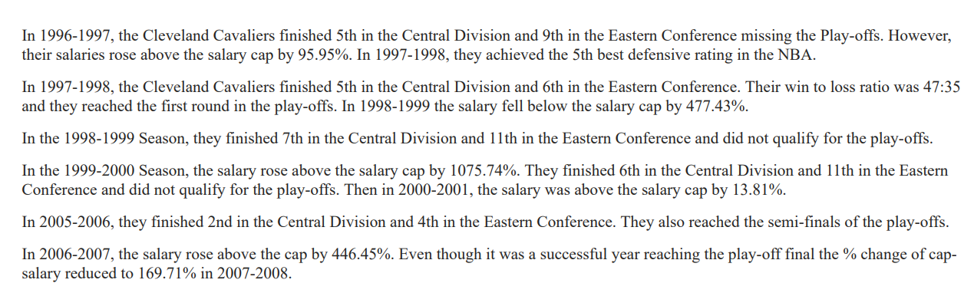

Slide 24
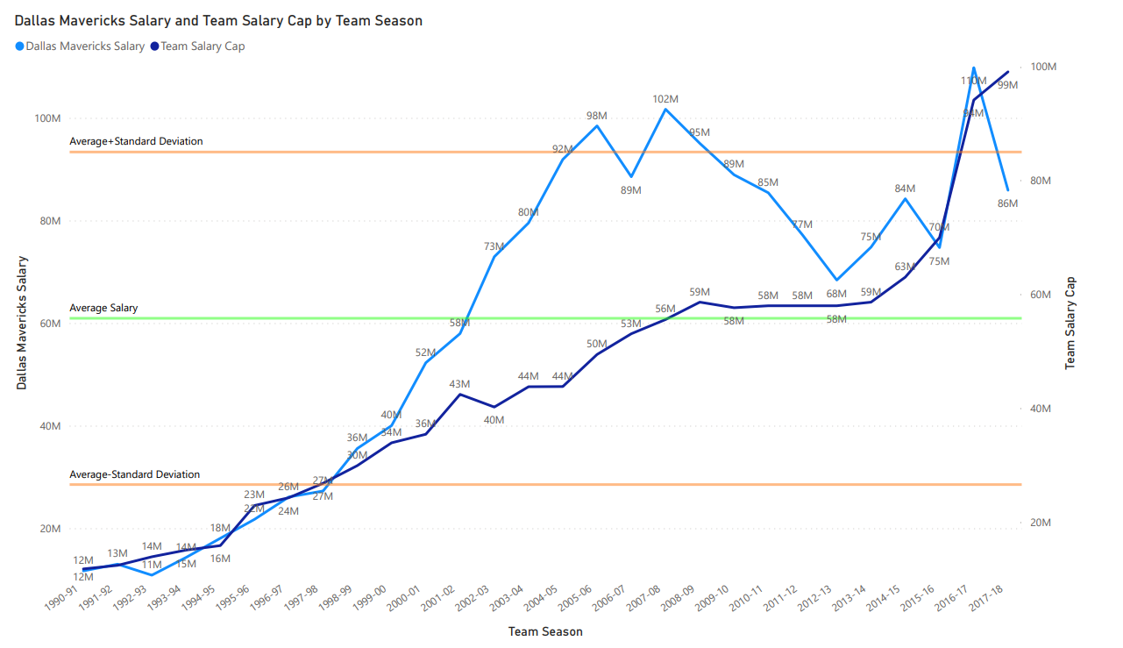

Slide 25
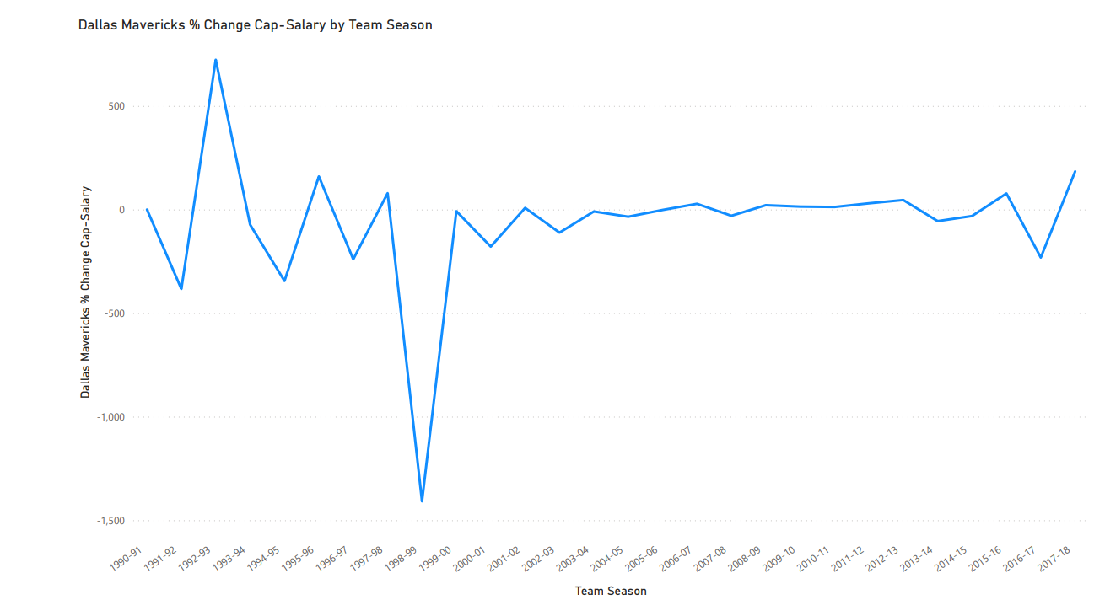

Slide 26
As we can see from the Line Graph of the Dallas Mavericks Salary alongside the team Salary Cap, the Salary started to increase gradually from the 1992-1993 to the 2005-2006 seasons despite the win to loss ratios being in favour of the losses.
From the 2000-2001 to the 2017-2018 seasons is the most successful period for the Dallas Mavericks, with the exception of three seasons where the win to loss ratios were in favour of the losses. During this period, they reached the Western Conference Semi-Finals four times, lost in the Conference Final twice and reached the first round of the Play-offs once.
In the 2005-2006 season, the team lost the NBA Final and the salary noticeably fell by $9.9 Million. There seemed to have been a consistent investment in the team’s salary to achieve the NBA Final but because they lost, the salary decreased the following season. In the 2006-2007 season, they reached the first round of the Play-offs and the salary rose by $13 Million.
From the 2007-2008 to the 2012-2013 season the salary fell consistently despite it being a successful period for the team during which they were NBA Champions in the 2010-2011 season. In the season following this the salary fell by $6.9 Million. Why would there be a salary decrease if it was the most successful season in the data set?.
From the 2013-2014 season until the end of the data set, the salary oscillated between an increase and a decrease and the highest finish they reached during this time was the first round of the Play-offs.

Slide 27
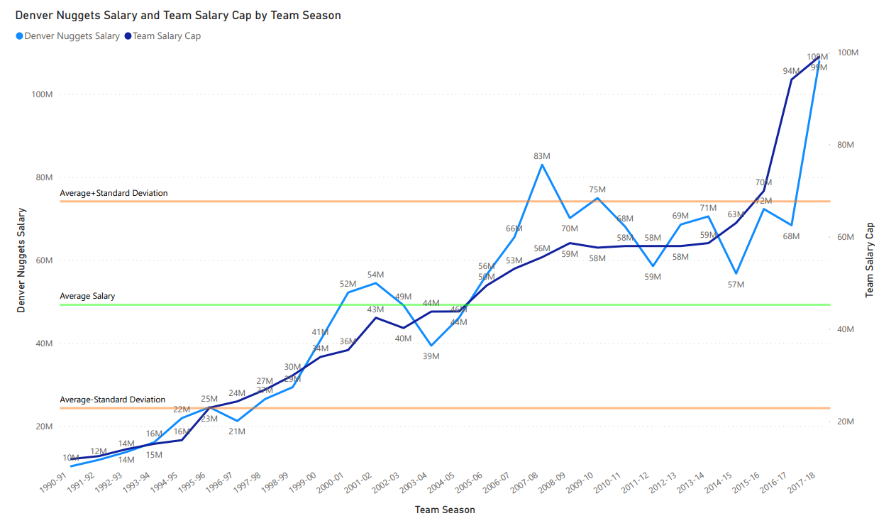

Slide 28
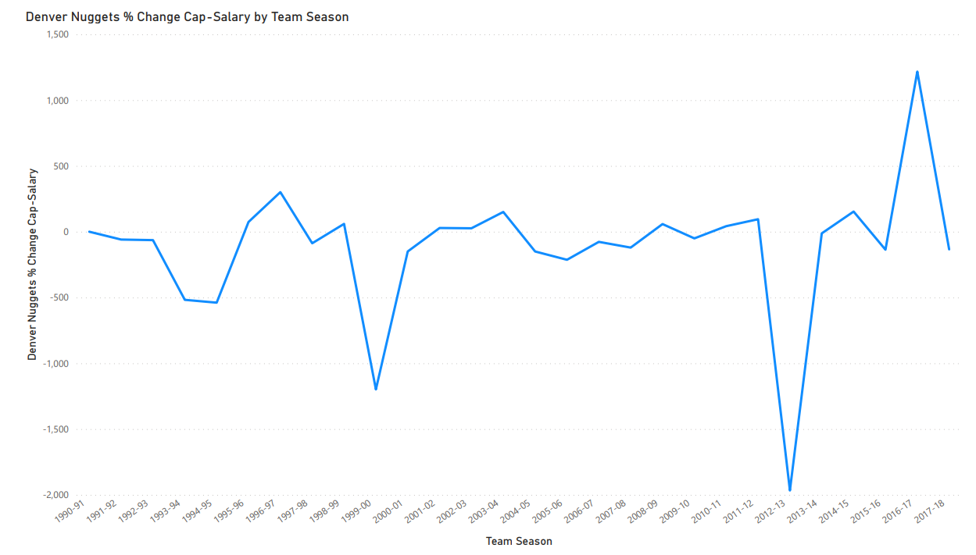

Slide 29
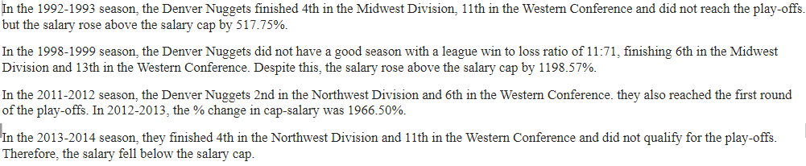

Slide 30
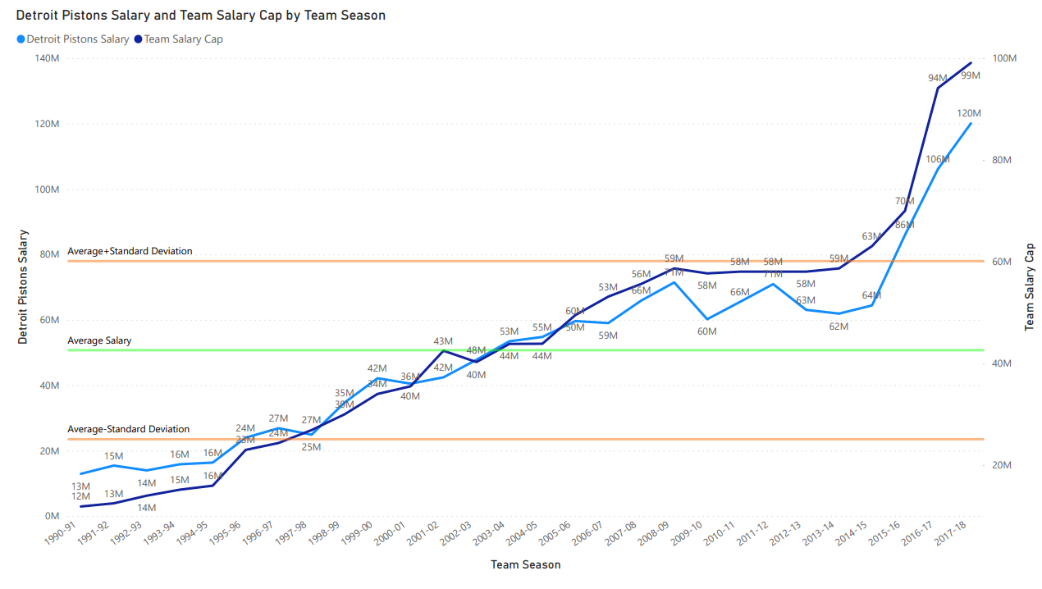

Slide 31
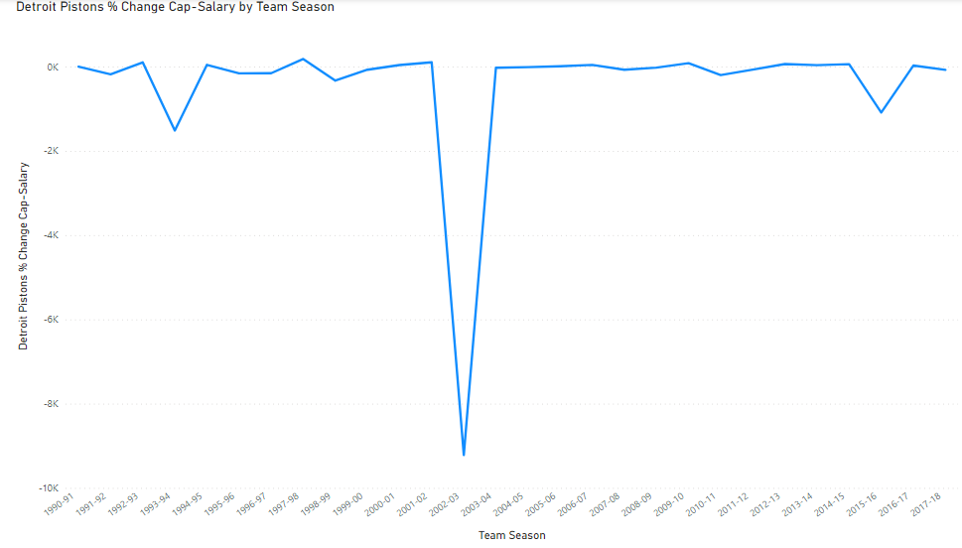

Slide 32
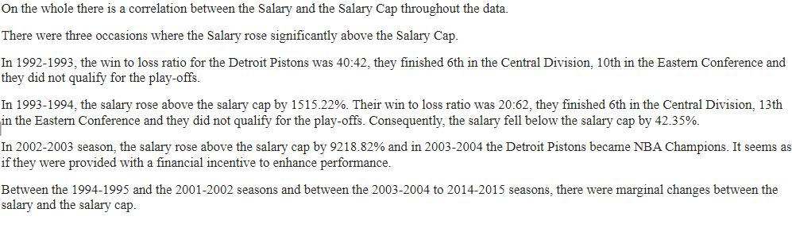

Slide 33
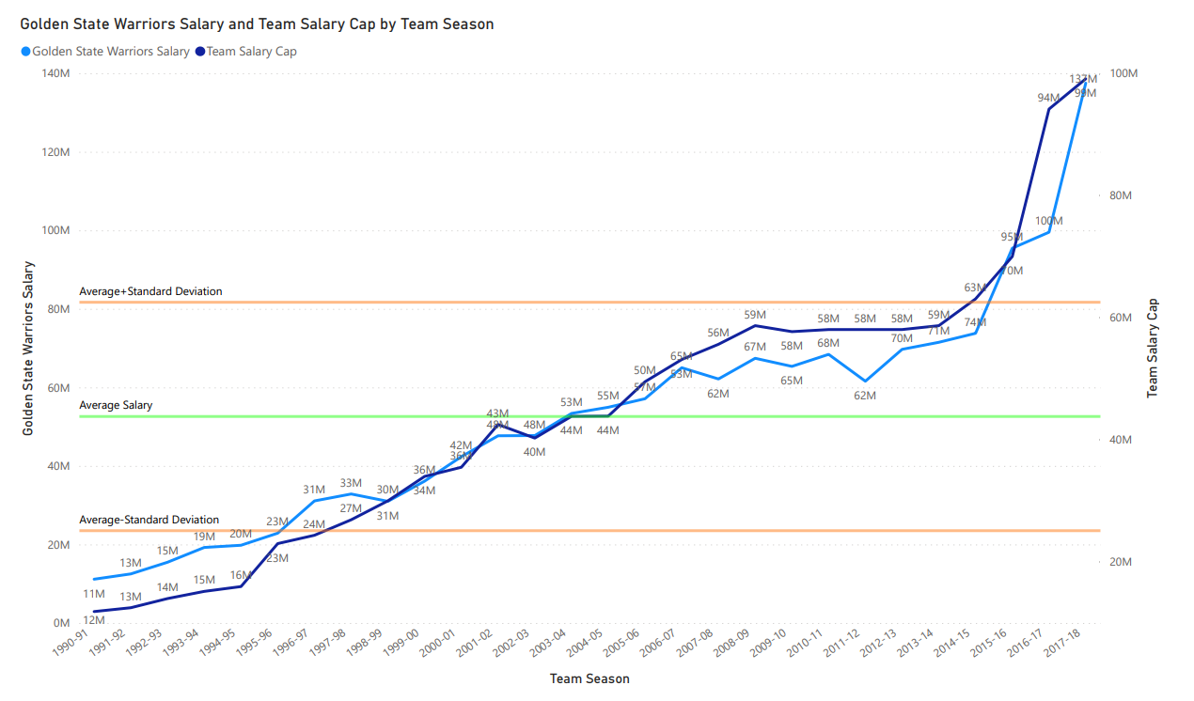

Slide 34
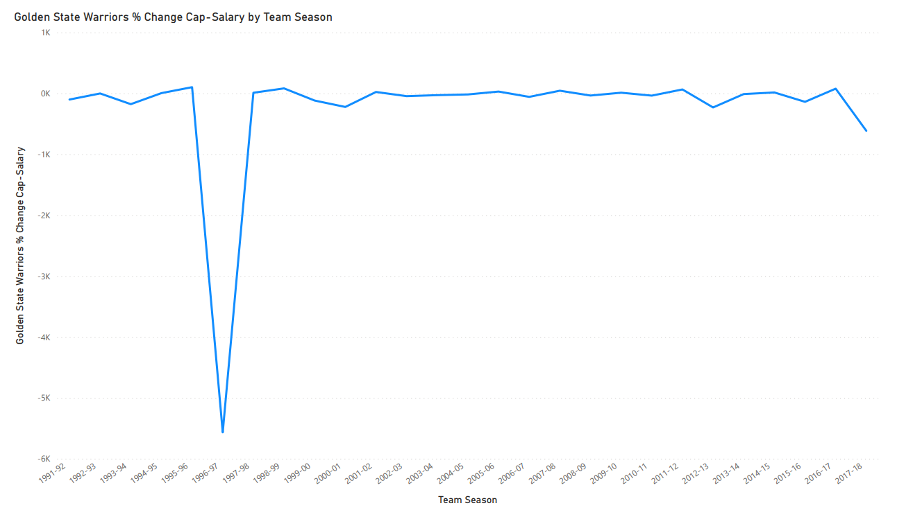

Slide 35
In the first three seasons out of four in the data set, the win to loss ratio was in favour of the losses, however the Salary kept rising consistently and was above the Salary Cap.
From the 1994-1995 to the 2005-2006 seasons, the win to loss ratio was in favour of the losses all throughout this period, but the salary kept rising regardless. In the 2006-2007 season, the win to loss ratio was in favour of the wins and they reached the first round of the Play-offs and the Salary fell by $3 Million the next season.
From the 2006-2007 to the 2012-2013 seasons the Salary oscillated from a decrease to an increase in Salary consecutively. As far as their performance was concerned within this period, at the beginning and at the end, they reached the first round of the Play-offs and the win to loss ratio was in favour of the wins. However, in between these times, the win to loss ratio was in favour of the losses.
From the 2012-2013 season until the end of the data set, the Salary kept increasing from one season to the next. It is during this period that the Golden State Warriors were at their most successful reaching the NBA Final four times and winning it three times, and reaching the Conference Semi-Finals and the first round of the Play-offs once. Throughout this time, the Salary was at it highest here than anywhere else in the data set and was consistently below the Salary Cap.
When the team won the NBA Final in 2014-2015 season, the following season the Salary rose by $12 Million. However, when they lost in the NBA Final in the 2015-2016 season, the Salary rose by $4 Million. In the 2016-2017 season, they won the NBA Final and the Salary rose by $38 Million. This shows that once the team reached the ultimate goal of becoming NBA Champions, the Salary increased the most the following season more than anywhere else in the data set.

Slide 36
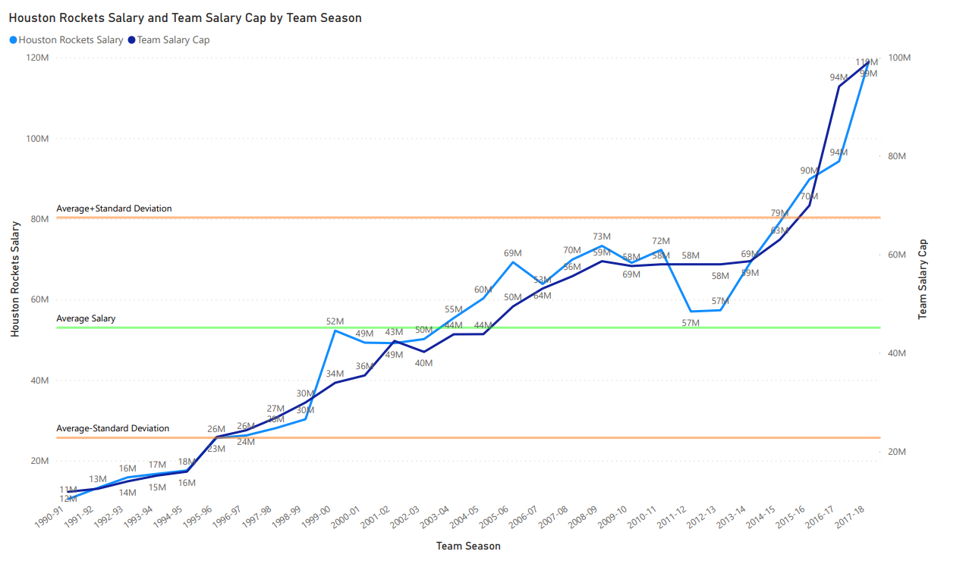

Slide 37
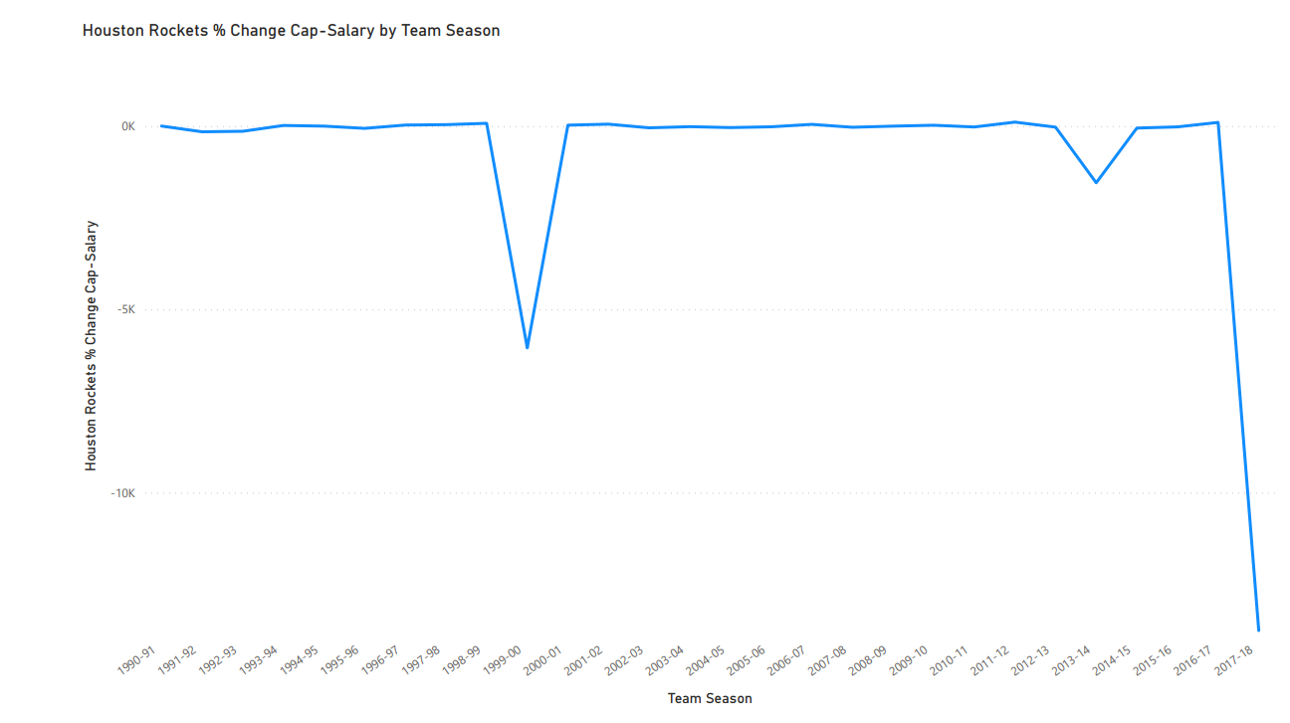

Slide 38
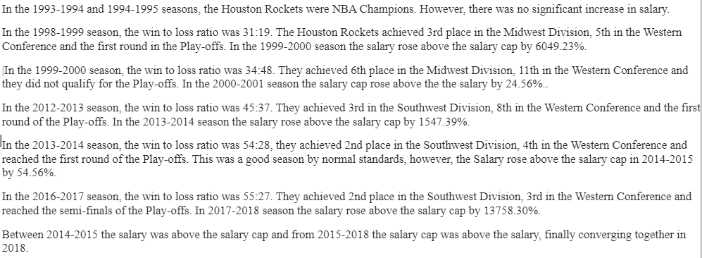

Slide 39
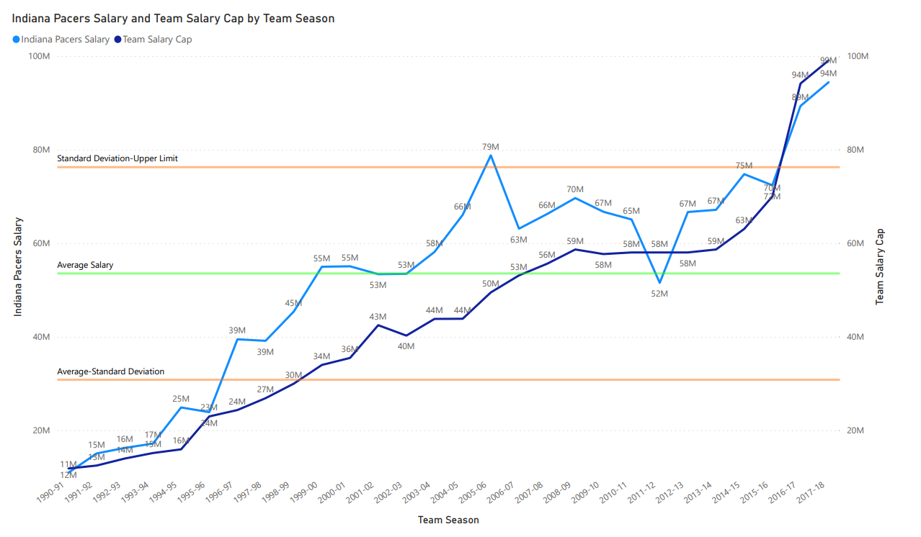

Slide 40
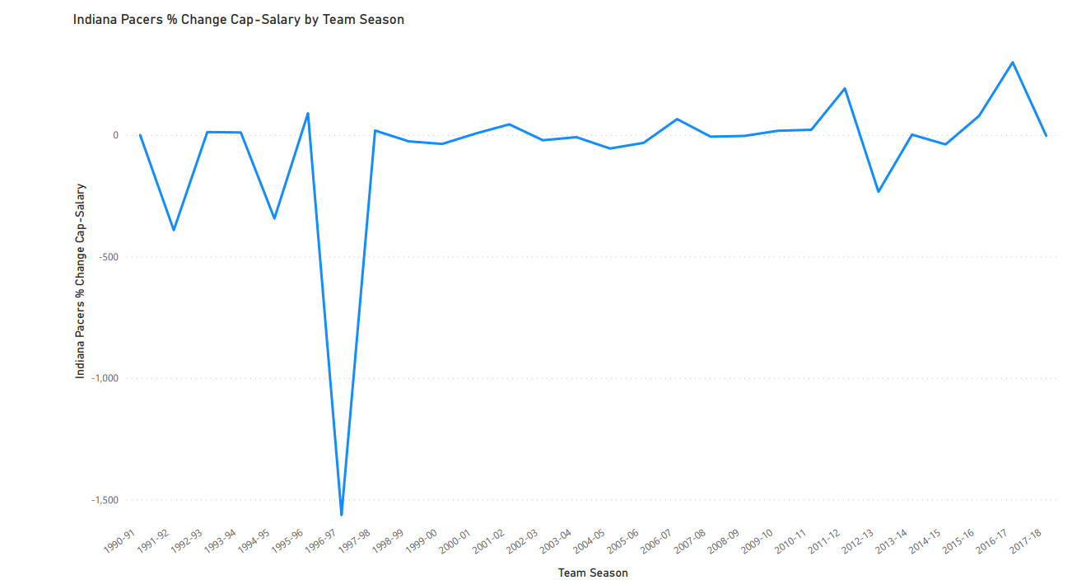

Slide 41
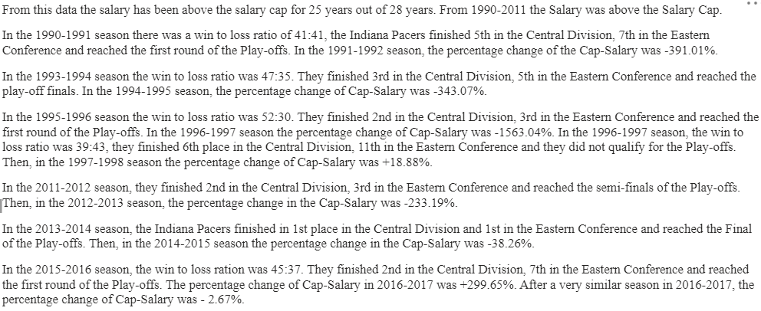

Slide 42
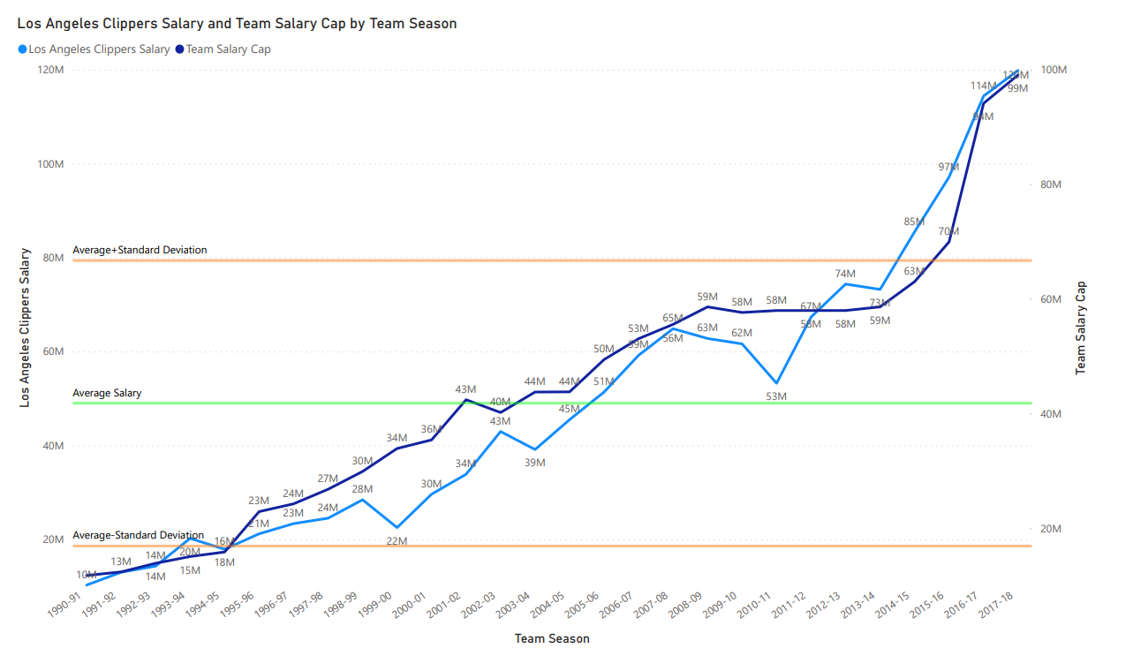

Slide 43
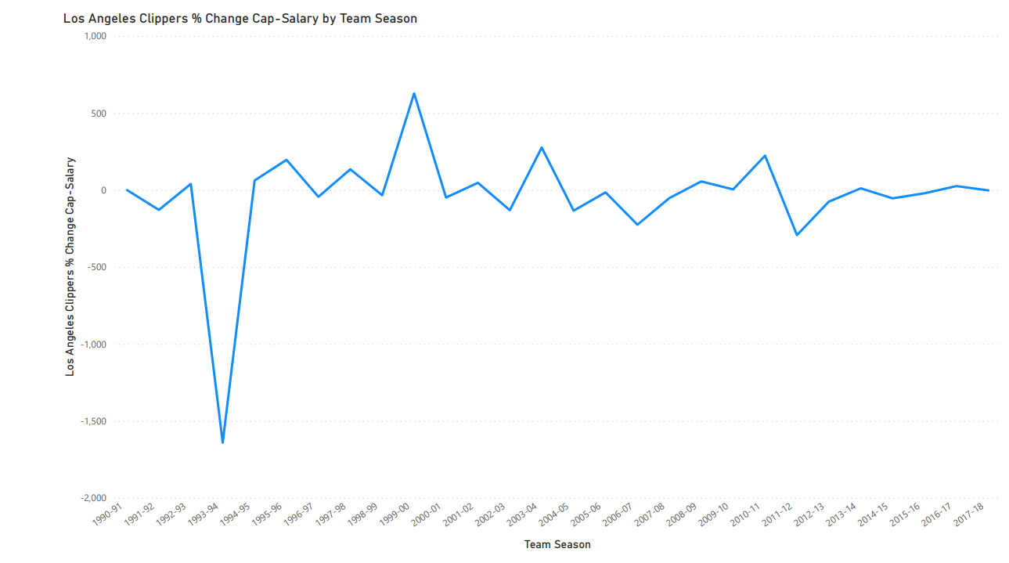

Slide 44
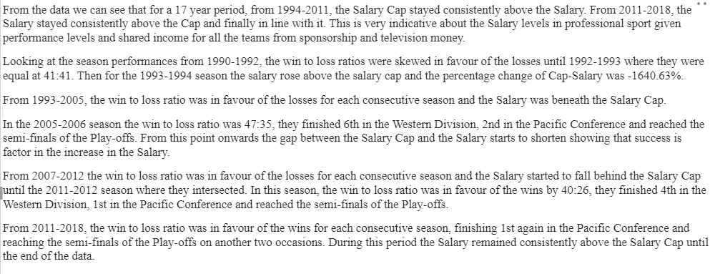

Slide 45
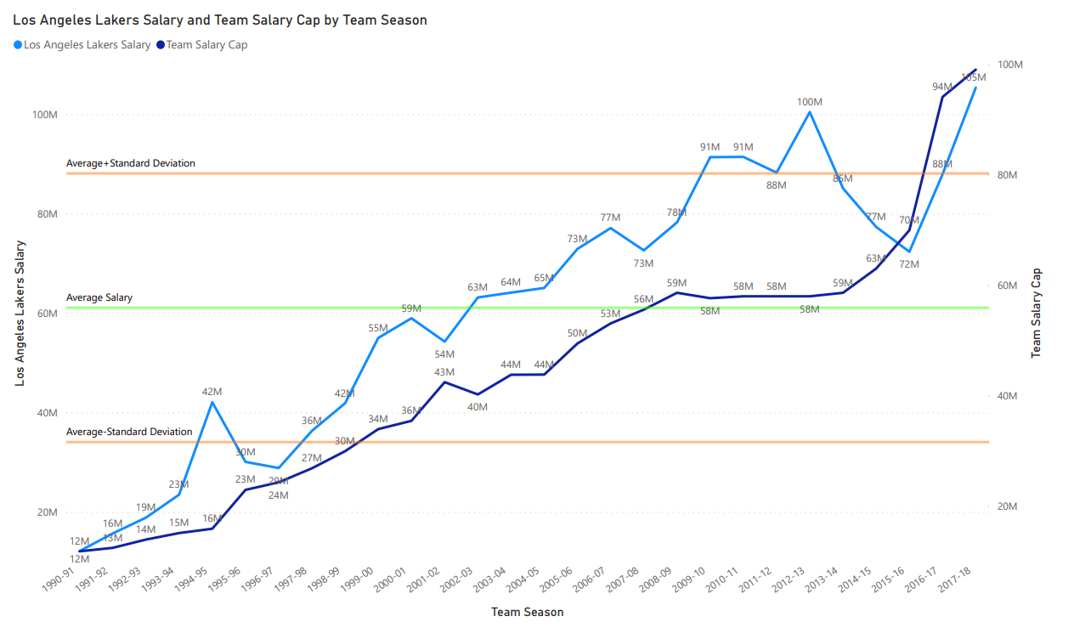

Slide 46
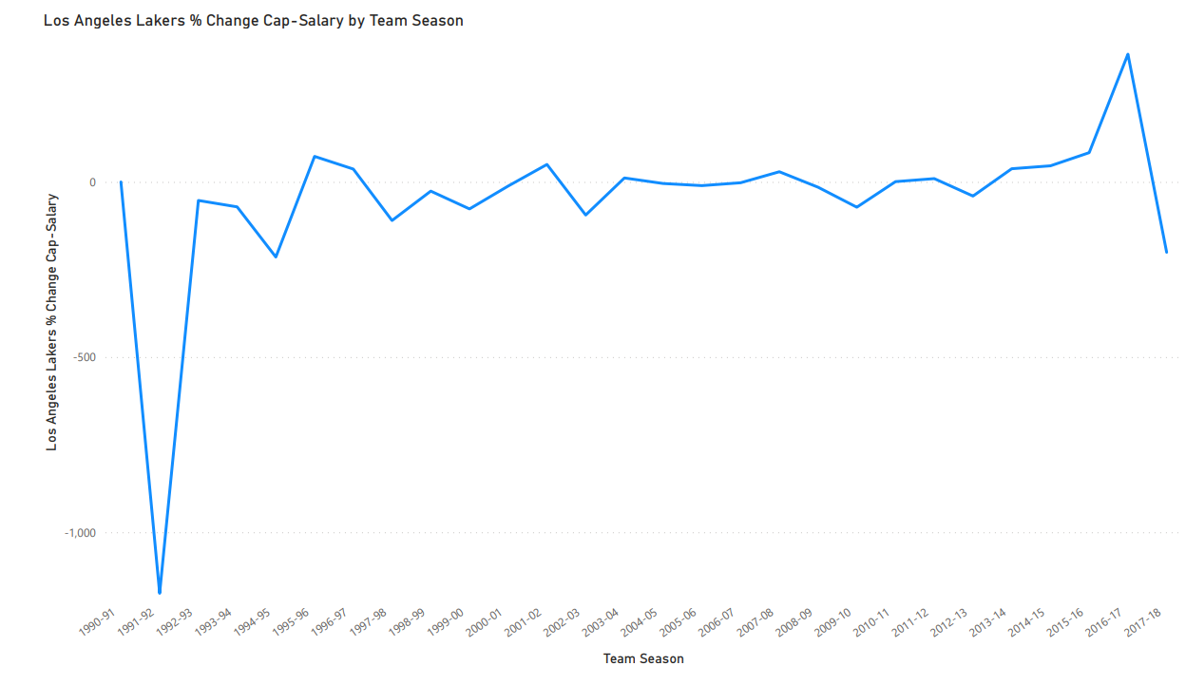

Slide 47
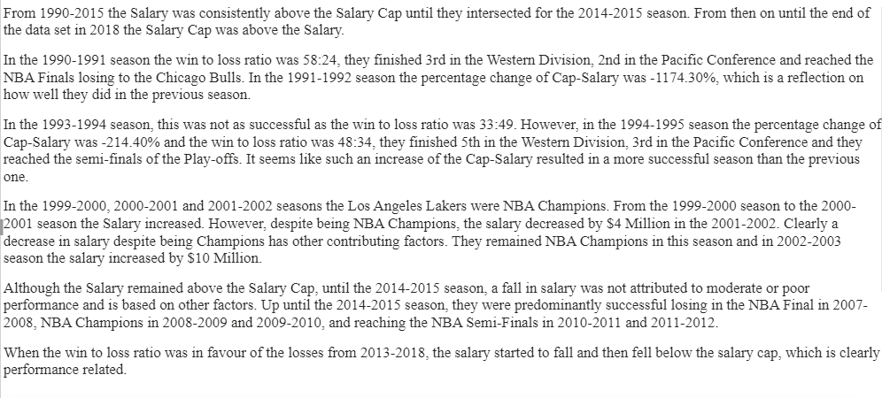

Slide 48
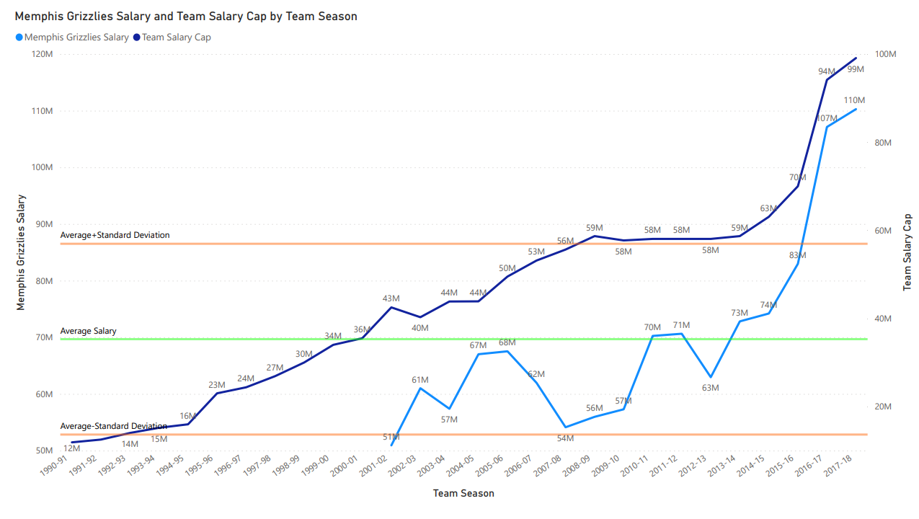

Slide 49
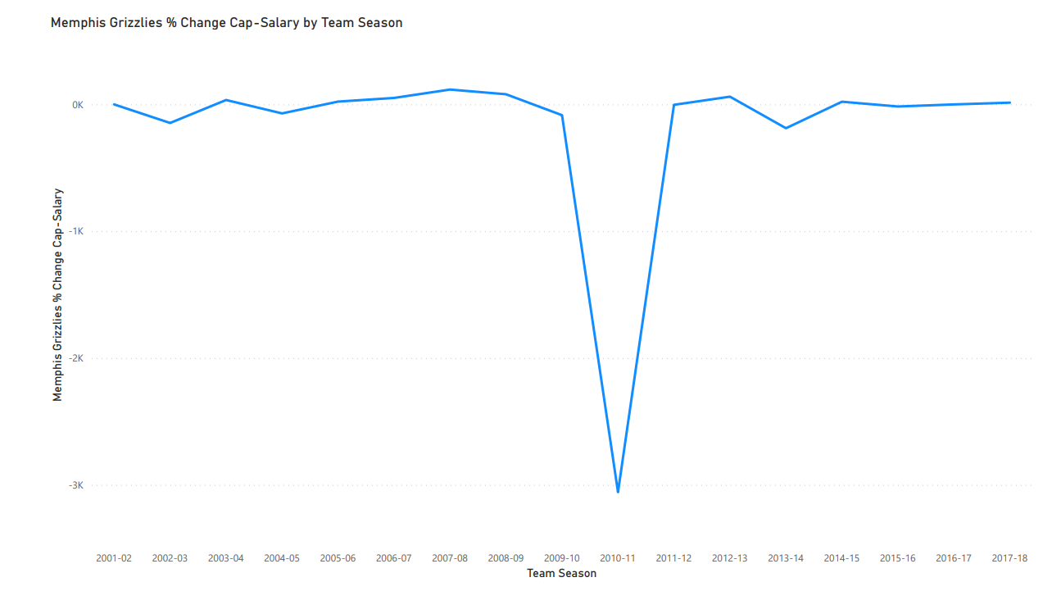

Slide 50
From the data we can see that the Memphis Grizzlies are a relatively new team to the NBA, as their data starts from the 2001-2002 season.
The first season in 2001-2002 was not a good season as the win to loss ratio was 23:59. In the following season, 2002-2003, the salary rose by $18 Million. However, that year the win to loss ratio was 28:54, and subsequently, the salary fell the following season by $4 Million.
Then in the season 2003-2004, 2004-2005 and 2005-2006, the win to loss ratio were all in favour of the wins, and the salary fell by nearly $11 Million.
Again from 2006-2010, the win to loss ratio was in favour of the losses from one season to the next and hence the salary fell beneath the salary cap until the 2010-2011 season. In the 2009-2010 season their performance improved, and in the 2010-2011 season the salary rose by $15 Million and they reached the Semi-Finals of the Play-offs with the percentage of cap-salary being -3056.75%.
In the 2011-2012 season, they reached the first round of the Play-offs and the salary in the 2012-2013 season fell by $8 Million.
In that season they reached the NBA Final and in the 2013-2014 season the salary rose by $10 Million.
As soon as the team did not reach the first round of the Play-offs, the salary started to fall gradually beneath the salary cap.
For this team, performance is a key indicator of how the salary rises and falls.

Slide 51
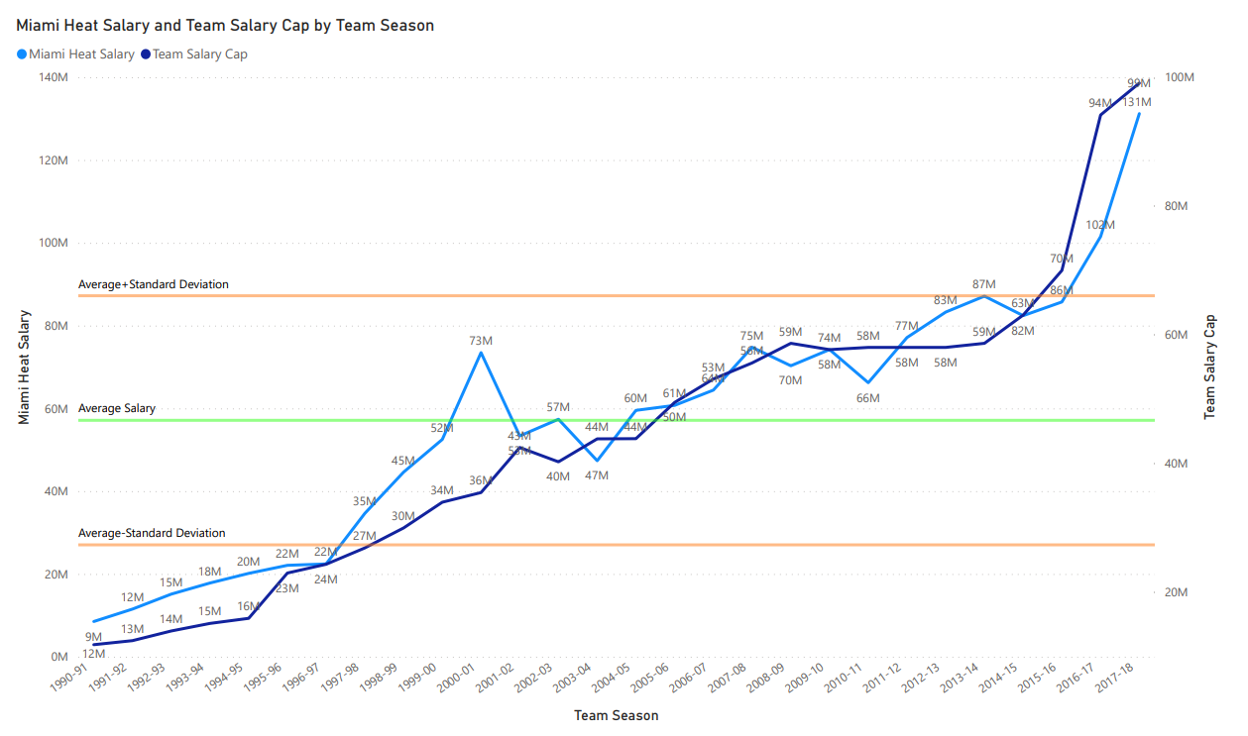

Slide 52
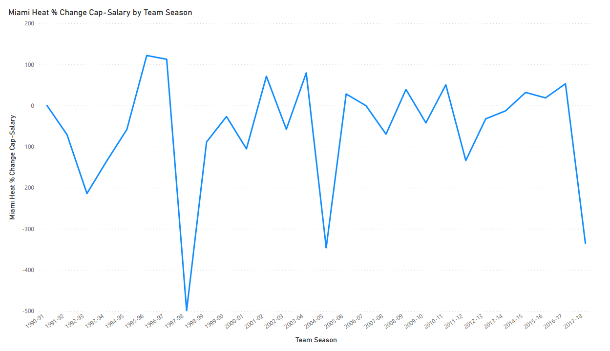

Slide 53
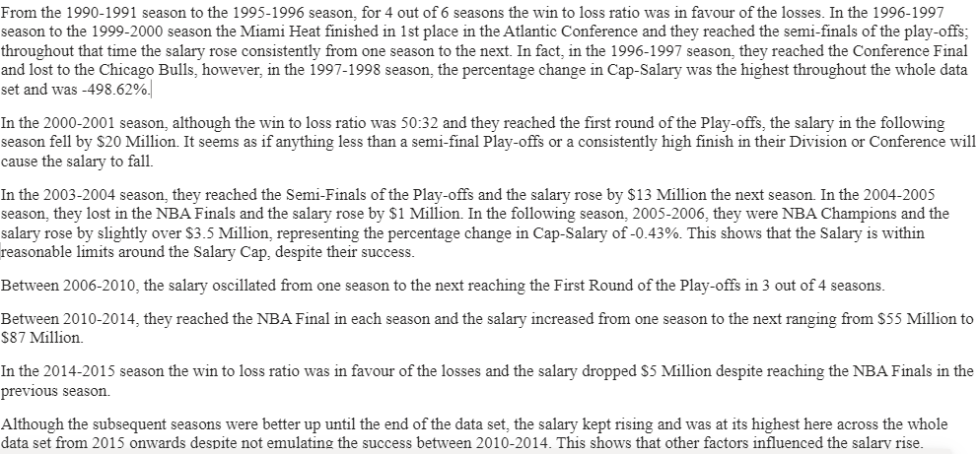

Slide 54
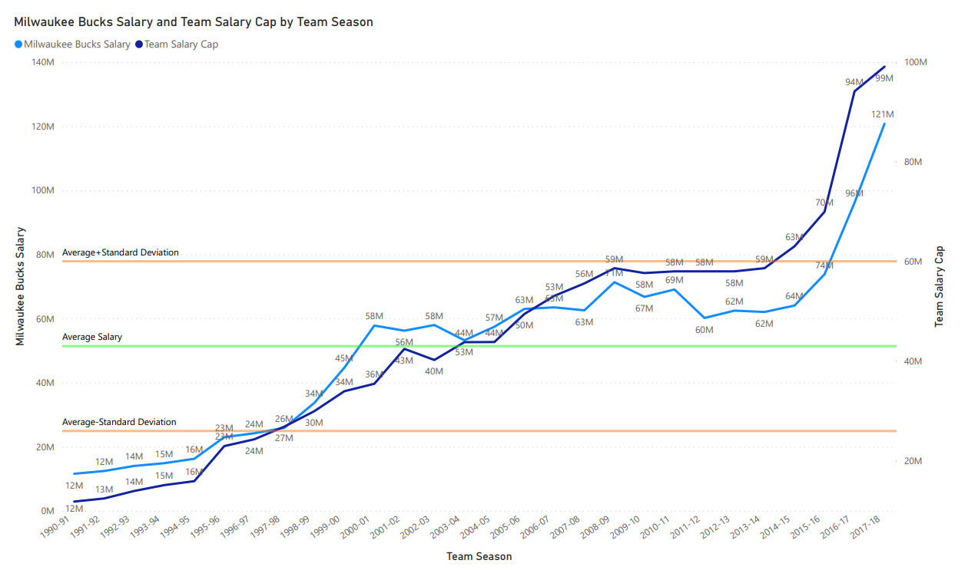

Slide 55
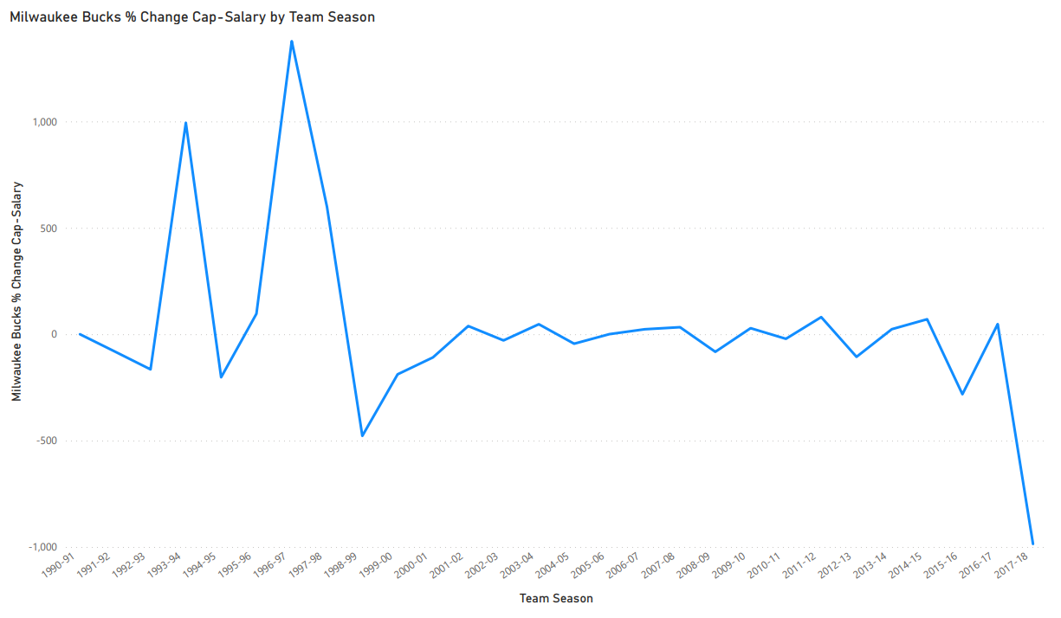

Slide 56
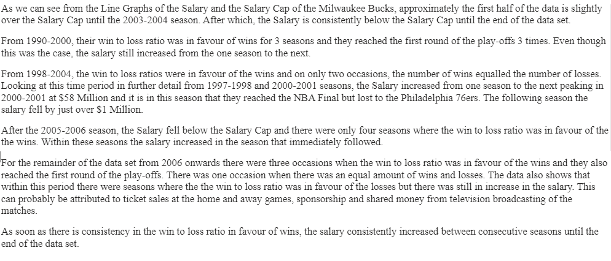

Slide 57


Slide 58


Slide 59


Slide 60


Slide 61


Slide 62


Slide 63


Slide 64


Slide 65


Slide 66


Slide 67


Slide 68


Slide 69


Slide 70


Slide 71


Slide 72


Slide 73


Slide 74


Slide 75


Slide 76


Slide 77


Slide 78


Slide 79


Slide 80


Slide 81


Slide 82


Slide 83


Slide 84


Slide 85


Slide 86


Slide 87


Slide 88


Slide 89


Slide 90


Slide 91


Slide 92


Slide 93


Slide 94


Slide 95


Slide 96


Slide 97


Slide 98


Slide 99


Slide 100


Slide 101


Slide 102


Slide 103


Slide 104


Slide 105


Slide 106


Slide 107


Slide 108


Slide 109


Slide 110


Slide 111
Conclusions
There is a correlation between the Salary and the Salary Cap. The Salary Cap is the benchmark for the salaries paid.
Seventeen to twenty years of data falls within the upper and lower Standard Deviation limits.
Generally, you would expect there to be an increase in salary after a successful season. Sometimes this is the case but it was not always guaranteed as my analysis indicated.
In some seasons, even though it was a relatively unsuccessful season, the salary still rose to significant levels. This is particularly evident towards the end of the data set. The reason for this could be indicative of how sport in general has evolved in respect of sponsorship deals, broadcasting income, ticket revenue, merchandising and wealthy investors. This is particularly evident also in other parts of the world such as the Premier League in England and Tennis.
A pattern emerged regarding the movement of the salary between successive seasons in particular time frames. The salary increased until their success reached a peak, and if it was not maintained, the salary decreased by a similar amount in subsequent seasons.
Significant increases in salary may have come from investors to encourage success such as winning the NBA Title.
In all of the data sets, the salary in the last few seasons of the data were at their highest there than anywhere else in the data. This is particularly evident past 2010. I can attribute this to how much the sport has changed in terms of how much money is circulating within the sport in terms of sponsorship, broadcasting income, ticket revenue, merchandising and wealthy investors.
It is rare that the Salary Cap is above the Salary for a long period of time. This happened with very few teams.
A fall in salary sometimes is not a reflection of moderate or poor performance.

Slide 112
Conclusions continued
10. Anything less than a high finish in their respective Division or Conference with less than a Semi-Final place in the Play-offs
caused a decrease in salary the next season. Some teams were stricter than others in this respect.
11. Some teams will stay within their Salary Cap despite their success.
12. Significant salary increases occur for some teams when they became NBA Champions, particularly if they achieved this in
successive seasons.
13. There were some teams where it is noticeable how a less than successful season resulted in an increase in salary.
14. For some teams, the salary rose in the latter part of the data set even though the win to loss ratio in each season was in favour of
the losses.
15. The Salary Cap was above the Salary post 2014 for most teams but they converged with each other towards the end of the data
set.

